Slide 1
2018 Maritime RobotX
Nanyang Technological University

Slide 2
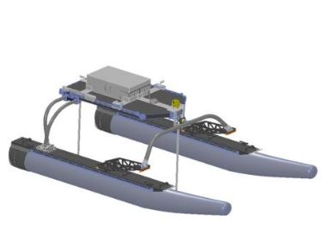
Introduction
Unmanned Surface Vehicle (USV) has been deployed intensively in recent years both in research use and in military use.
In research field, USV can be assigned to do ocean observation in replace of traditional methods, such as buoys, drifters and even human ship operation.
Comparing with the traditional methods, the deployment of USV is low cost, efficient, easy to recover and energy saving.
Also, the data collected is accurate, intensive and can cover many areas.

Slide 3
Hardware components
Processing unit: Embedded PC, On shore PC
Communication unit: Antenna, Access point
Detection unit: Lidar, Camera-vision signal detection, Hydrophone- Acoustic signal detection
Location and motion unit: GPS, IMU
Motor controller: PLC
Power supply and safety: Battery, Inverter, Emergency Stop
Mechanical Fixture: Three Azimuth propellers

Slide 4
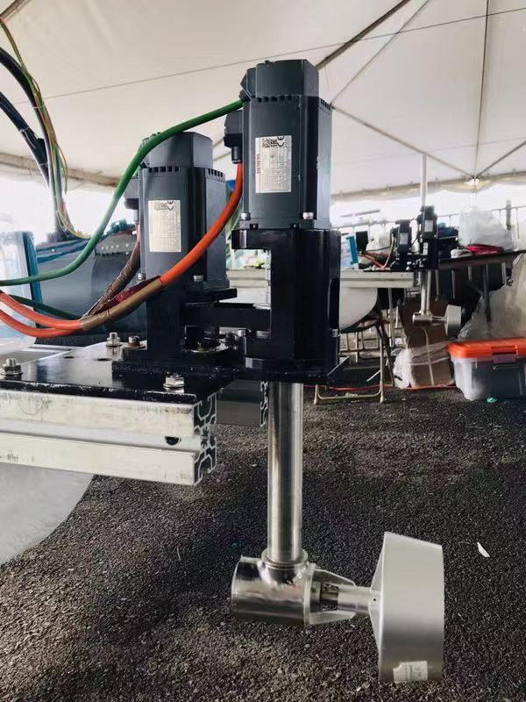
Control system
Dynamic Positioning System
Use propellers to provide forces against the environmental forces generated by wind, waves and currents, so that the ship remains at the required position on the sea level.

Slide 5
Control system
Mechnical System
Each propeller set is made of 2 servor motors.
One controls the angle trough synchronous belt.
Another one controls the RPM of propeller.

Slide 6
Control system
System layout
All motors controlled by PLC, which is controlled by the NUC.
All motors controlled by PLC.
Emergency stop and outputs also connected to the PLC.
NUC
Control Value
Hardware Input
PLC
Output
Signal
Status
Signal
STOP
M
M
M
M
M
M
Servor Motors

Slide 7
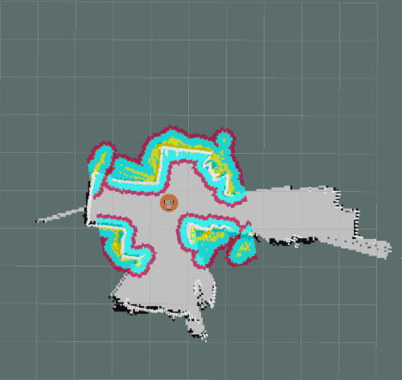
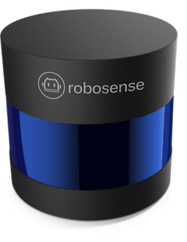
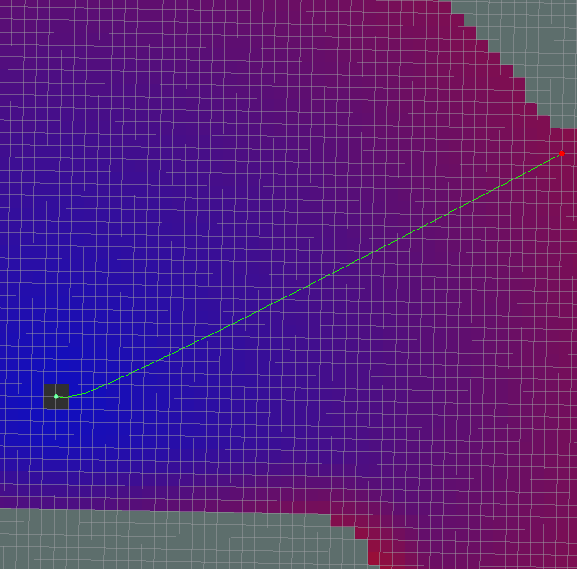
Path planning
Point cloud of the surroundings
Generate
2D Costmap
Path of vessel
ROS navigation
(Dijkstra‘s algorithm)
PLC
Data from GPS and IMU

Slide 8
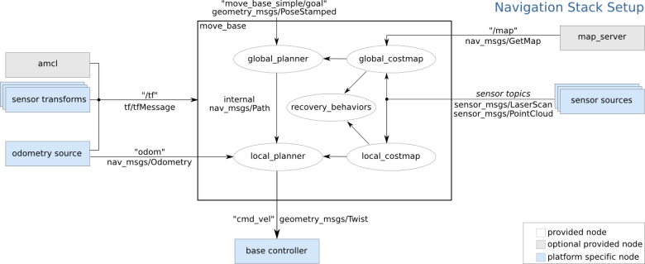
Path planning
Overview of ROS navigation
Pointcloud from lidar
Data from GPS and IMU

Slide 9
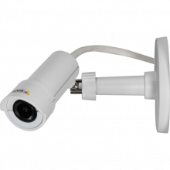
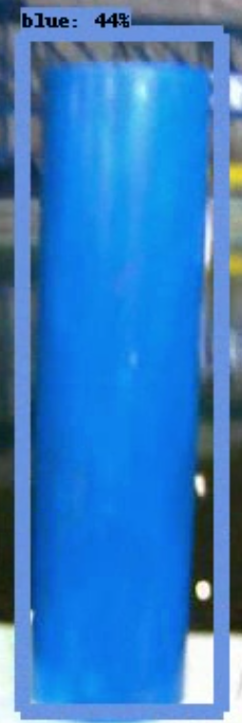
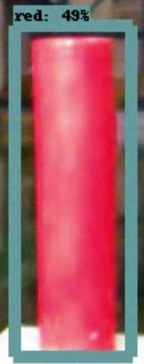
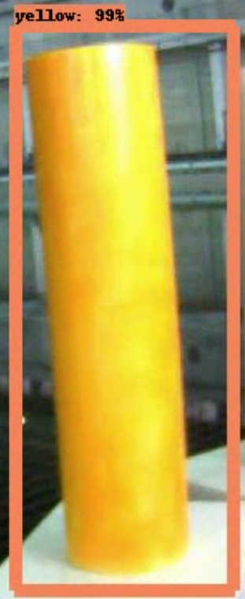
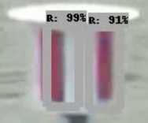
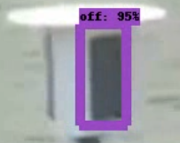
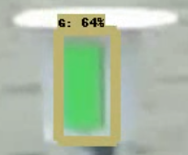
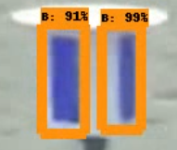
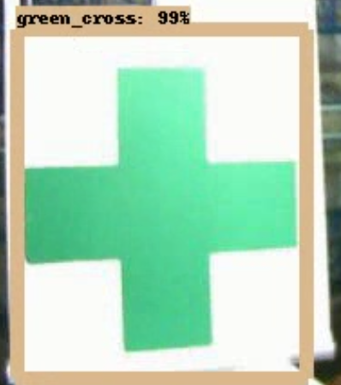
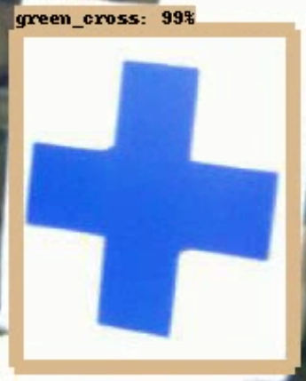
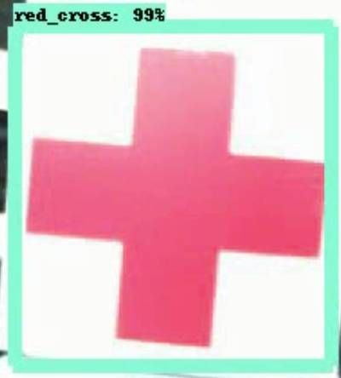
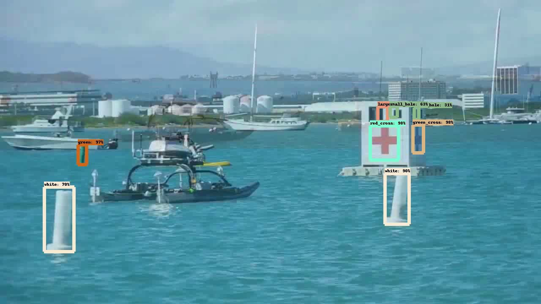
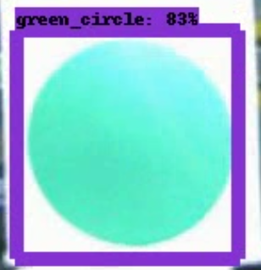
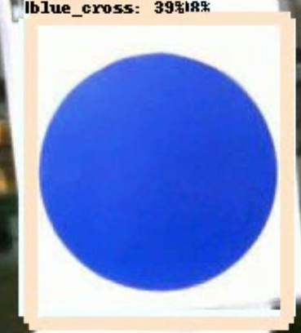
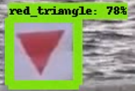
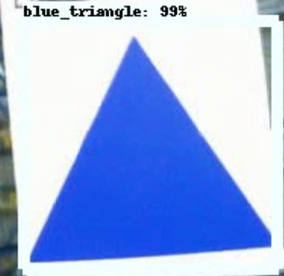
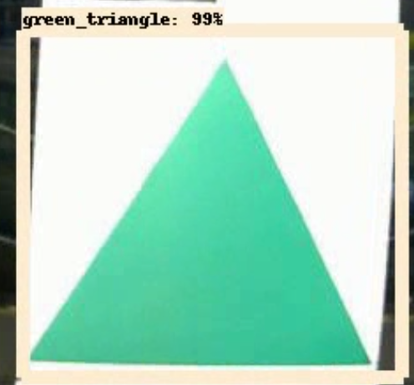
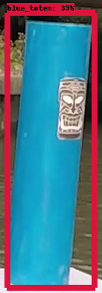
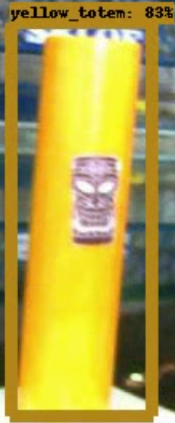
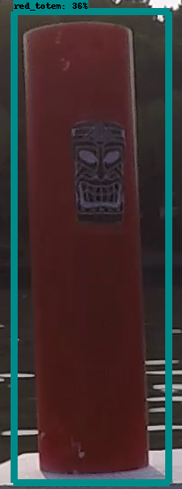
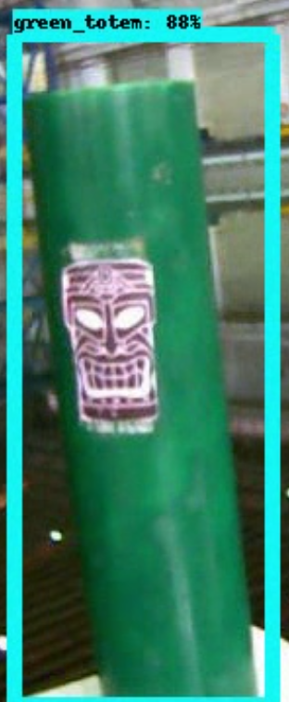
Vision
Detection of Object of Interest
3D Coordinates of the Object of Interest
Query on Images based on Lidar-Camera Calibration
25 classes
Bounding Boxes of 25 Classes of Objects for RobotX 2018 tasks
Detection of Object of Interest based on DL
Notes:
Calibrate the Lidar with cameras.
Calibration is to compute the intrinsic and extrinsic matrix.
After the calibration is completed, the projection from lidar to camera can be calculated from the intrinsic and extrinsic matrix.

Slide 10
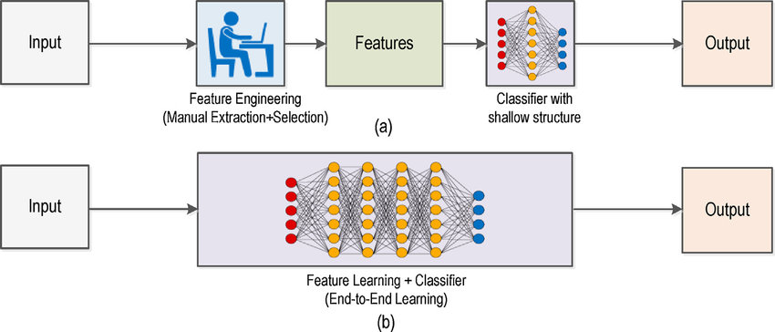
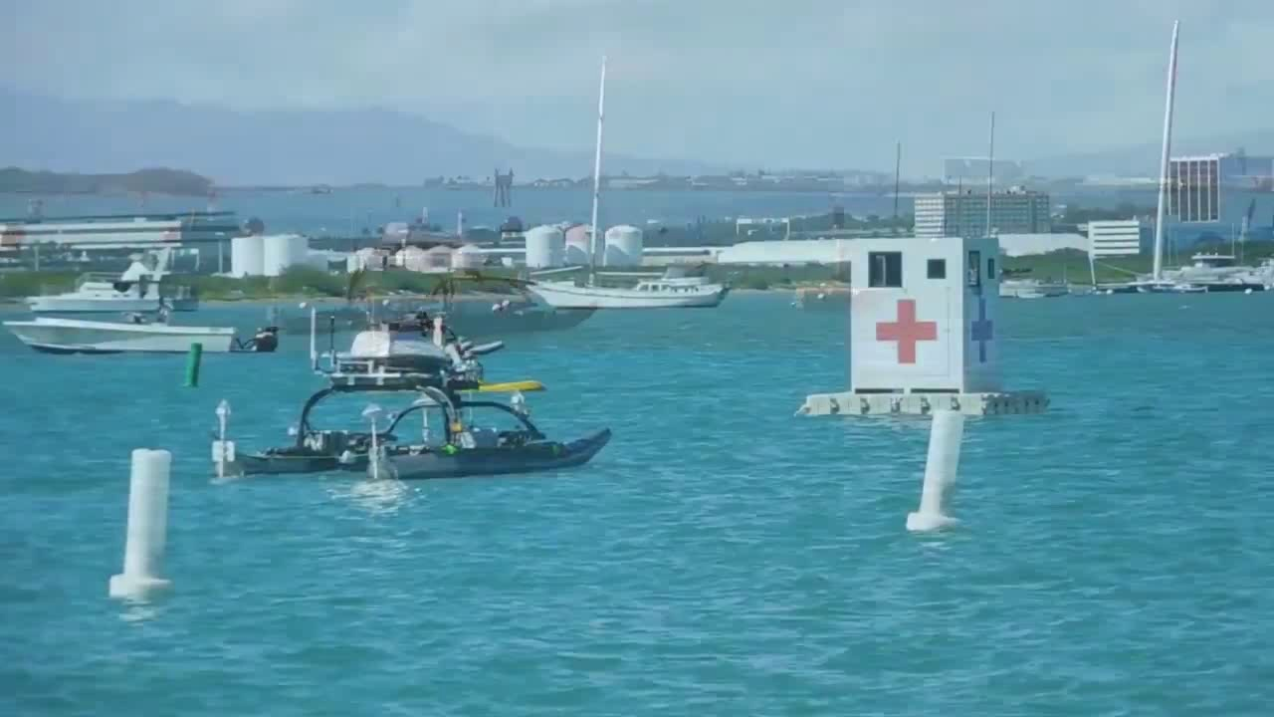
Vision
MobileNet + SSD
Running on NUC or TX2
Notes:
Object Detection based on Deep Learning
Use deep learning for object detection.
Use transfer learning to get a good performance model with little training data.
When the object is detected, the object’s range, category, and score will be obtained.

Slide 11
Task strategy
Demonstrate Navigation and Control
Use lidar to coordinate the positon of the start and end gate. Vision system are used to assist in recognizing the pairs of start gate and end gate.
The system can determine the direction and create way points for the boat. The actual GPS data and orientation will feedback to system to determinate the differences between current way point and the calculated way points.
The task is completed after the boat exit the end gate.

Slide 12
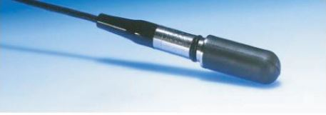
Task strategy
Entrance and Exit Gates
Close to the first gate and use a hydrophone to detect the frequency of the signal. Then determine the distance of the signal based on the energy of the signal.
Choose the correct gate to enter, use the vision system and lidar to detect the location of the target.
Plan path to circumnavigate the target.
Use the same strategy to choose correct gate to leave.

Slide 13
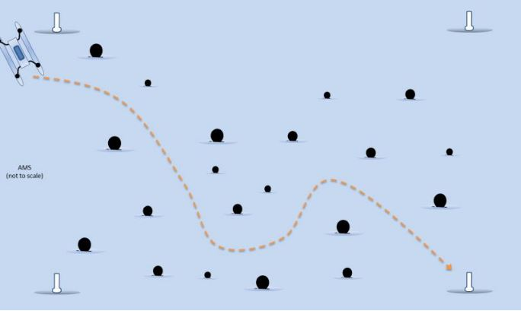
Task strategy
Avoid Obstacles
Plan the path from the start point to the end point.
Use the vision system and lidar to detect the location of the obstacle.
Under the premise of reaching the end point, the boat can adjust the path in real time to avoid obstacles

Slide 14
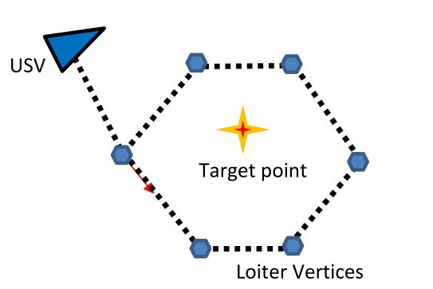
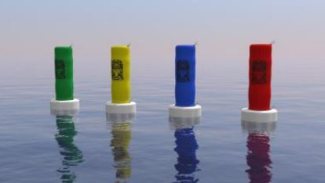
Task strategy
Find Totems
Use the vision system to identify the totems and lidar to detect the location of the totems.
Plan path to circumnavigate the correct totems in the correct direction.

Slide 15
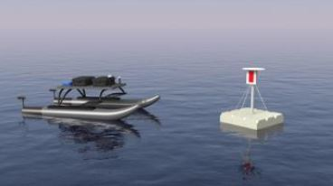
Task strategy
Scan the Code
Dynamic positioning in front of the platform and scan the light bar with the vision system.
Analyze the video and report the detected light sequence.

Slide 16
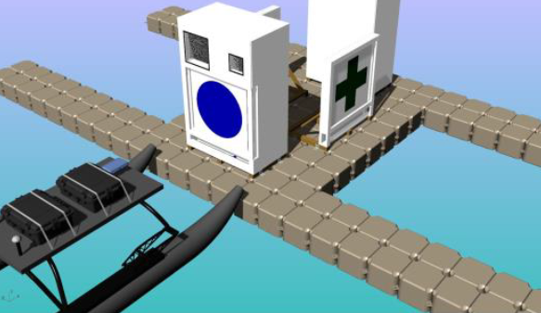
Task strategy
Identify Symbols and Dock
Identify the symbols with the vision system and detect the location of the symbols with lidar.
Plan path to dock and exit the docking bay.

Slide 17
Task strategy
Detect and Deliver
There is a mechanical rod that extends out of the boat from the side. The ball is placed in a bottle.
Dynamic positioning to move the rod to reach into the hole. Then the rod is rotated 180 degrees to make the ball fall.

Slide 18
THANKS

